Slide 1
UnitedHealthcare/OptumRx Approach to CAA Pharmacy Benefits and Costs Reporting
November 10, 2022
© 2022 United HealthCare Services, Inc. All Rights Reserved.
Important: The content in this guide reflects UnitedHealthcare/ OptumRx carve in and UMR approach. The guide includes content from: ¹ CMS Reporting Instructions as noted throughout.

Slide 2
Reporting for ASO - What is required?
To understand how UnitedHealthcare and the self-funded customer will support the submission of data and applicable narrative, refer to the following information. The CMS instructions define data requirements, including the following letter and number identifiers.
Requirements¹: Plans, issuers, and carriers must submit one or more plan lists (P1, P2, P3), eight data files (D1 through D8), and a narrative response.
Those identifiers beginning with P stand for Plan
P1: Individual and Student Market plans
P2: Group Health plan list (most commercial business) required for employer-based health plans that are
not FEHB plans
P3: FEHB plan list
The plan lists identify the Employer group and plans in a submission. The plan lists also collect plan-level information, such as the beginning and end dates of the plan year, number of members, and the states in which the plan or coverage is offered.
P2 Definitions - What is a Group Health Plan?
Group Health Plan Name will be the employer group health benefit plan
Client Group Health Plan Name should already be completed in the 5500 website
UHC will reconcile to the Group Health Plan Name based on the Plan Sponsor name in the
5500
Where blank, UHC will default to the customer's name in UHC's system
Group Health Plan Number will be the unique plan identification number.
UHC will use the EIN from our system as the unique plan identification number
UHC will reconcile to the Plan Sponsor EIN from the 5500
website
For companies that use multiple EINs, UHC will use the primary EIN associated with the 5500
Please note: Any entity that submits a Data file, must also submit a corresponding P2. Therefore, there will be multiple submitters of P2. The Client will submit a Master P2 record which will incorporate the details for all TPAs and PBMs who will be submitting Data on their behalf.
Best practice: As noted, data from the 5500 website should be used to ensure consistency in the submission of P2 by multiple parties. The Client should use the Group Health Plan Name based on the Plan Sponsor Name and the Group Health Plan Number based on the Plan Sponsor EIN.
Narrative¹ - A narrative response is required to describe the impact of prescription drug rebates on premium and cost sharing. UnitedHealthcare will submit the appropriate Narrative for each Data file submitted.
Market Segment¹ is also required
For mixed-funded plans, which generally self-fund some benefits and fully insure other benefits, submitters must report the self-funded business in the self-funded market segment and the fully-insured 2 business in the fully insured market segment.
The table has the names and abbreviations for the market segments. Submitters must use the appropriate abbreviation when filling out plan lists and data files. The exact spelling of the abbreviation must be used.
© 2022 United HealthCare Services, Inc. All Rights Reserved.

Slide 3
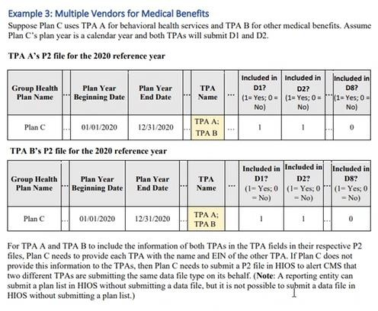
Creating a Master P2
The P2 identifies each unique Group Health Plan and is the common thread to link all D files to a particular Group Health Plan.
Clarification was received from CMS which implies that if the Group Health Plan uses multiple TPAs or PBMs, a P2 should be submitted by the Group Health Plan which incorporates all TPAs, PBMs and associated EINs. We are referring to this as the Master P2. The Master P2 will be used by CMS to identify the TPAs and PBMs who may also submit P2 and D files on behalf of the Employer group.
We are referring to this as the Master P2, which should be created by the Group Health Plan and will include all TPAs and PBMs that will submit a Data file on their behalf.
The Master P2 will be used by CMS to identify the full list of TPAs and PBMs who may also submit P2 and Data files on behalf of the Employer group.
Each TPA or PBM will submit their own corresponding P2 along with the Data files they submit on behalf of the Employer group.
Note: P2 requires the count of Members as of 12/31 of the Reference Year
UHC will include all Members in the policy (including retirees) in the submission for the Pharmacy Benefits and Costs data. We do not have the ability to exclude Retirees from reporting.
3

Slide 4
Reporting for ASO - Data Definitions¹
Those identifiers beginning with a D, stands for Data and reference the 8 distinct files of information required in the report. All self-funded D files will be aggregated by TPA/market segment/state (principal place of business). All fully insured D files will be aggregated by Issuer/market segment/state (where the policy was issued).
D1: Premium and Life Years
D2: Spending by Category
D3: Top 50 Most Frequent Brand Drugs
D4: Top 50 Most Costly Drugs
D5: Top 50 Drugs by Spending Increase
D6: Rx Totals
D7: Rx Rebates by Therapeutic Class
D8: Rx Rebates for the Top 25 Drugs
D1**: Premium and Life Years Clients will submit this data in a shared arrangement. Note: Safe Harbor applies Premium reporting for 2022.
Premium: For self-funded plans and other arrangements that do not rely exclusively or primarily on premiums, report the premium equivalent amounts representing the total cost of providing and maintaining coverage, including claims costs, administrative costs, Administrative Services Only (ASO) and other TPA fees, and stop-loss premiums. An employer with a self-funded plan may use, as the total cost of providing and maintaining coverage, the same costs that are taken into account for purposes of calculating COBRA premiums (minus the 2% administration charge, if applicable).
Report the ASO and other fees paid to the TPA. This amount should also be included in Premium Equivalents.
Life-years are the average number of members in the plan throughout the year.
D1: Premium Safe Harbor ¹
For the 2020 and 2021 reference years only, the Safe Harbor states: “If you have obtained the required information, you must report it. However, the Departments recognize there may be significant challenges to obtain information about employer premium contributions, especially when a contractual relationship began before the passage of the CAA. Accordingly, the Departments will not take enforcement action related to the requirement to report average monthly premium paid by employers versus members for the 2020 and 2021 reference years if those data elements are reported in RxDC report for the 2022 reference year and all future reference years.”
Important: The content in this guide reflects UnitedHealthcare/ OptumRx carve in and UMR approach. The guide includes content from: ¹ CMS Reporting Instructions as noted throughout.
4

Slide 5
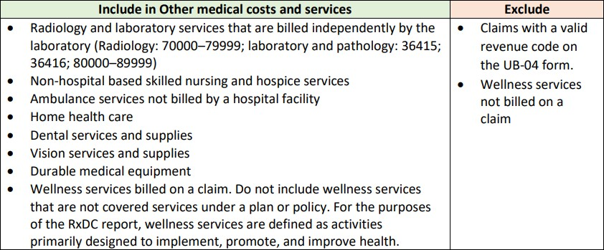
Reporting for ASO - Data Definitions¹
D2: Spending by Category
Claims paid under medical, includes Behavioral claims
Instructions state to NOT report spending on pharmacy benefit drugs anywhere in D2 Spending by Category.
D2: Spending by Category definitions (continued)
Hospital: spending on services provided by hospitals to members and billed by the facility.
Primary care: spending on clinical health care services provided by a primary care provider in doctor’s office or outpatient care center.
Specialty care: spending on clinical health care services provided by specialists.
Other medical costs and services: spending for all other professional and facility clinical health care services and equipment not reported as hospital, primary care, or specialty care.
Medical Benefit Drugs: known amounts (informational): spending on drugs covered under a medical benefit that are separately billed or otherwise known exactly. The amounts reported here are also included in the hospital, primary care, specialty care, or other medical costs and services categories.
Medical benefit drugs: estimated amounts (informational): estimated portion of bundled or alternative payment arrangements (or other non-fee for service amounts) that can be attributed to drugs covered under a medical benefit. The amounts reported must also be reported in the hospital, primary care, specialty care, or other medical costs and services categories.
Cost Sharing: deductibles, coinsurance, and copays, including amounts that may have been paid through a health savings or reimbursement account.
Important: The content in this guide reflects UnitedHealthcare/ OptumRx carve in and UMR approach. The guide includes content from: ¹ CMS Reporting Instructions as noted throughout.
5

Slide 6
D3: Top 50 Most Frequent Brand Drugs
For each RxDC brand name drug, calculate the total number of paid claims in a state and market by adding the number of paid claims for every NDC associated with the RxDC brand drug name.
CMS will indicate which drugs are considered brand name drugs.
Rank the drugs in each state and market segment according to number of paid claims, sorted in descending order.
Identify the 50 brand name drugs with the highest number of paid claims.
Create a table with the top 50 drugs and include a row for every state, market segment, and EIN of the issuer or TPA.
D4: Top 50 Most Costly Drugs
For each RxDC drug, calculate total spending, net of prescription drug rebates, fees, and other remuneration, in the state and market segment by summing total spending for every NDC associated with the RxDC drug name.
Rank the drugs in the state and market segment according to total spending, sorted in descending order, and identify the 50 drugs with the greatest total spending.
Create a table with the top 50 drugs and include a row for every state, market segment, and EIN of the issuer or TPA.
For each row, report total spending and the other utilization and spending variables in the file layouts.
D5: Top 50 Drugs by Spending Increase
For each RxDC drug, calculate total spending, net of prescription drug rebates, fees, and other price concessions, in the state and market segment by summing total spending for the reference year for the NDCs associated with the RxDC drug name.
For each RxDC drug, calculate the increase in total spending by subtracting total spending in the state and market segment for the year prior to the reference year from total spending in the state and market segment for the reference year.
If spending on a drug increased from one year to the next, the difference will be a positive number.
If spending on a drug decreased from one year to the next, the difference will be a negative number.
Rank the drugs in each state and market segment according to the increase in total, sorted in descending order.
D6: Rx Totals
Report information about prescription drugs covered under the pharmacy benefit.
D7: Rx Rebates by Therapeutic Class
A therapeutic class is a group of drugs that have a similar mechanism of action or treat the same condition. Therefore, they are assigned the same RxDC therapeutic class name. If an NDC has more than one ingredient and those ingredients belong to different therapeutic classes, the RxDC therapeutic class name is the combination of the therapeutic classes.
D8: Rx Rebates for the Top 25 Drugs
For each RxDC drug, calculate total rebates, fees, and other remuneration in the state and market segment by summing total rebates, fees, and other remuneration for every NDC associated with the RxDC drug name.
Rank the drugs in the state and market segment according to total rebates, fees, and other remuneration, sorted in descending order. Identify the 25 drugs with the greatest amount.
**Stop Loss: Premium equivalents (self-funded coverage) D1
For self-funded plans and other arrangements that do not rely exclusively or primarily on premiums, report the premium equivalent amounts representing the total cost of providing and maintaining coverage, including claims costs, administrative costs, Administrative Services Only (ASO) and other TPA fees, and stop-loss premiums.
An employer with a self-funded plan may use, as the total cost of providing and maintaining coverage, the same costs that are taken into account for purposes of calculating COBRA premiums (minus the 2% administration charge, if applicable).
Important: The content in this guide reflects UnitedHealthcare/ OptumRx carve in and UMR approach. The guide includes content from: ¹ CMS Reporting Instructions as noted throughout.
6

Slide 7
Reporting for ASO - Who is responsible for data submission?
CAA PHARMACY BENEFIT AND COST REPORTING FOR ASO CUSTOMERS
All Groups except USP and UMR | All UMR and USP Groups
UHC / OptumRx Carve-In | UHC / UMR
SHARED DATA SUBMISSION | UHC/UMR SUBMITS ALL DATA
National Accounts, Key Accounts, Public Sector, Surest™ | Includes All Savers/Level Funded, Healthscope Benefits
Self-funded customer must submit P2, and D1 directly to the CMS site UHC/OptumRx carve-in submits P2, D2, D3-D8 | UHC (USP)/UMR submits P2, D1, D2, D3-D8
We will report our data in aggregate as supported by CMS aggregation instructions. NOTE: UHC will submit P2 and Data files directly to the CMS portal as required. UHC is unable to provide individual customer specific reporting
Multiple Reporting Entities: A plan, issuer, or carrier can allow multiple reporting entities to submit on its behalf. The submission for a plan, issuer, or carrier is considered complete if CMS receives all required files, regardless of who submits the files. Multiple reporting entities should not submit the same data file for a plan, issuer, or carrier. Each reporting entity must submit one or more plan list files (P2), that is how CMS will know when multiple entities are reporting for the same Group health plan. A common Group Health Plan Name and Group Health Plan Number will tie multiple submissions to a single employer group health plan. Carve Out Arrangements: Some clients will need to coordinate with other carriers based on carve out arrangements. If OptumRx is not the PBM (customer carves out pharmacy benefits) including OptumRx Direct (carve out) or other PBMs, carve out wellness, behavioral and/or carve out stop loss, the ASO customer needs to ensure their carrier(s) submit the appropriate files: Carve out Pharmacy carrier will submit: • OptumRx Direct (carve-out) clients received a request from P2: Including PBM Name & PBM EIN OptumRx to confirm the D2 approach. ^{D3-D8} • The D2 data is aggregated at the medical benefit/vendor Carve out Stop Loss carrier will submit: ^{reporting entity level.} ^{P2: TPA Name & TPA EIN} • OptumRx will report at the aggregated level. This means that D1: Stop Loss Premium Equivalents clients would be combined with all other ORx clients who had Carve out Wellness carrier will submit: their D2 files aggregated by the medical vendor P2: TPA Name & TPA EIN D2: Wellness Services when billed on a claim Note: if the wellness carrier does not pay claims, UHC will submit the corresponding medical claim data in aggregate Carve out Behavioral carrier will submit: P2: TPA Name & TPA EIN D2: Behavioral when billed on a claim Note: if the behavioral carrier does not pay claims, UHC will submit the corresponding medical claim data in aggregate Please note: FEHB (P3) will follow the Fully Insured process. ** If customer does not offer wellness or stop loss follow the full-service administrator process. ** If a customer has multiple full-service carriers, follow the full-service administrator process. Important: The content in this guide is largely based on the direction provided by CMS: ¹ CMS Reporting Instructions
© 2022 United HealthCare Services, Inc. All Rights Reserved. 6

Slide 8
ASO Customers who commit to submit their data and narrative to the CMS portal directly
Although not recommended, should the self-funded customer prefer to submit their data directly in the CMS portal, the customer may make a request for summarized data files and narrative through their Sales and Account Management Team.
There may be a fee associated with this request, when it includes pharmacy data.
For customers who already requested, we will provide the customer with their own specific data and narrative as required in the CMS instructions.
Customer may be required to sign an NDA.
Reminder: self-funded groups with carve-out arrangements will need to obtain and then submit data and narrative from those organizations, where applicable.
To ensure delivery of data, customers must have requested this option by September 30 deadline.
The requested data and appropriate narrative will be provided to the customer in late November 2022
Data is only provided directly to the customer if they have fully committed to filing with CMS in its entirety. When a customer performs their own submission of the reporting, That employer group will not appear in the aggregate report that we submit.
Select data sets for files that we submit to CMS directly are not also provided to the customer.
For OptumRx Direct (carve out) business, the customer must obtain data from OptumRx directly.
For plan year 2022 reporting by June 2023, UnitedHealthcare will provide customers with an updated timeline.
UnitedHealthcare National Accounts, Public Sector, Key Accounts, and Surest™ (BIND)
Data Requests can be made for each of the following summarized files
D2: Spending by Category
D3 to D8 (In total)
UMR, USP including All Savers/Level Funded and Healthscope Benefits
Data Requests can be made for each of the following summarized files
P2: Group Health plan list
D1: Premium and Life Years
D2: Spending by Category
D3 to D8 (In total)
Note: UHC will report data in aggregate as supported by CMS aggregation instructions.
If a client were to report their data, UHC will send their specific information and remove them from our aggregated file.
8

Slide 9
Narrative Response¹
UHC will submit the appropriate Narrative Response for each data file. The CMS instructions include details as to the information required in the Narrative Response.
Examples include:
Employer size for self-funded plans
Identify whether actual counts or estimates were used to determine the size of the employer for self- funded plans
Describe the estimation method if estimates were used
Net payments from federal or state reinsurance or cost-sharing reduction programs
Drugs missing from the CMS crosswalk
Medical benefit drugs
Prescription drug rebate descriptions, impact and allocation methods
Describe the impact of prescription drug rebates on the tier assignment of prescription drugs in the formulary, or the removal of generic equivalents from a formulary. If possible, provide a quantitative estimate of the impact
And so forth …
Form 5500 Plan Number¹
Form 5500 Number – Mandatory for fully insured and ASO filing
Location: P2
If applicable, enter the 3-digit plan number reported on the IRS Form 5500 filed with DOL. If there is more than one value, separate them with a semicolon.
It is the Group Health Plan’s responsibility to file the Form 5500. For reference, here is the link to the
U.S. Department of Labor Form 5500 Search Tool: https://www.efast.dol.gov/5500Search/
5500 data is expected to be found in the 5500 site for most employer groups.
Terminated Groups
We will follow the standard approach as indicated below for groups that were active in 2020 or 2021. The terminated client will have a shared responsibility to submit their P2, D1 data directly to CMS.
All Groups except USP and UMR | All UMR and USP Groups
UHC / OptumRx Carve-In | UHC / UMR
SHARED DATA SUBMISSION | UHC/UMR SUBMITS ALL DATA
National Accounts, Key Accounts, Public Sector, Surest™ | Includes All Savers/Level Funded, Healthscope Benefits
Self-funded customer must submit P2, D1 directly to the CMS site UHC/OptumRx carve-in submits D2, D3-D8 | UHC (USP)/UMR submits P2, D1, D2, D3-D8
Important: The content in this guide reflects UnitedHealthcare/ OptumRx carve in and UMR approach. The guide includes content from: ¹ CMS Reporting Instructions as noted throughout.

Slide 10
Legal Entity and EIN
Following please find the Legal Entity and EIN combinations for TPA Name and EIN and PBM Name and EIN. This information may be shared, upon request:
Legal Entity | EIN
UMR, Inc. | 39-1995276
United HealthCare Services, Inc. | 41-1289245
OptumRx, Inc. | 33-0441200
HealthSCOPE Benefits, Inc | 71-0847266
Oxford Health Plans LLC | 52-2443751
Bind Benefits Inc | 81-4560965
State Aggregation ¹
The state aggregation rules for RxDC are like the requirements in the MLR reporting form instructions. In general, a reporting entity should report fully-insured business in the state where the policy was issued.
For self-funded plans, the reporting entity should generally report the data in the state where the plan sponsor has its principal place of business. When a plan covers members in multiple states, or when coverage is sponsored by a group trust, association, or multiple employer welfare arrangement (MEWA), the reporting entity should follow the instructions below.
Coverage in Multiple States:
For self-funded coverage that is not provided through a group trust, association, or MEWA, report the data in the state where the plan sponsor has its principal place of business.
For fully-insured plans, report the data in the state where the policy was issued.
For FEHB carriers that are not associated with an issuer, TPA, or other third-party vendor and that offer coverage in multiple states, report the data in the state where the policy was issued or where the carrier has its principal place of business
Important: The content in this guide reflects UnitedHealthcare/ OptumRx carve in and UMR approach. The guide includes content from: ¹ CMS Reporting Instructions as noted throughout.

Slide 11
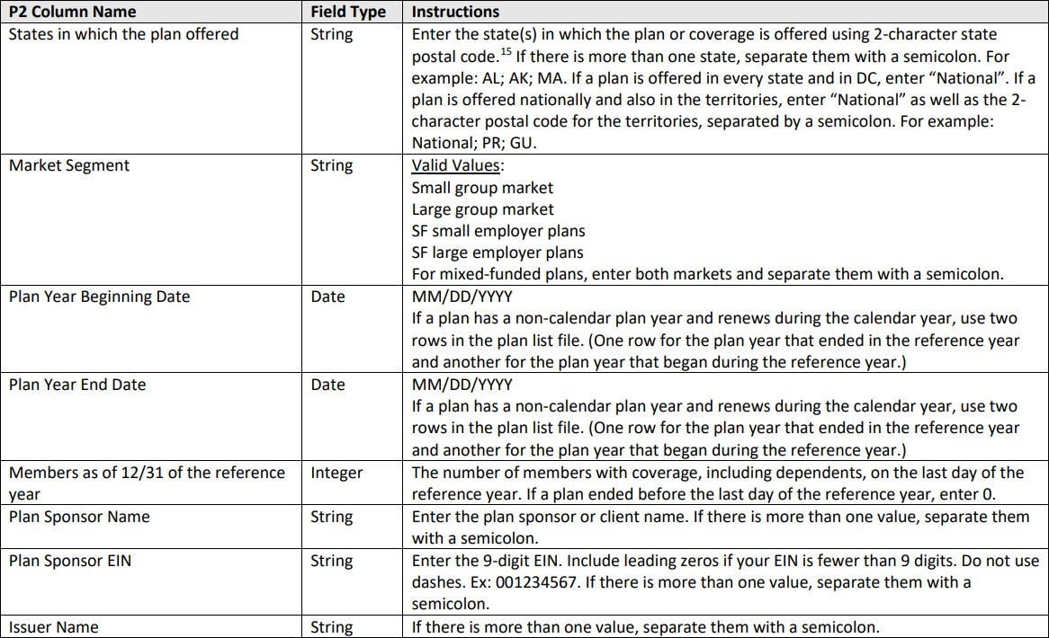
P2 Group Health Plan List¹
UHC will submit
Does not apply to ASO
Important: The content in this guide reflects UnitedHealthcare/ OptumRx carve in and UMR approach. The guide includes content from: ¹ CMS Reporting Instructions as noted throughout.

Slide 12
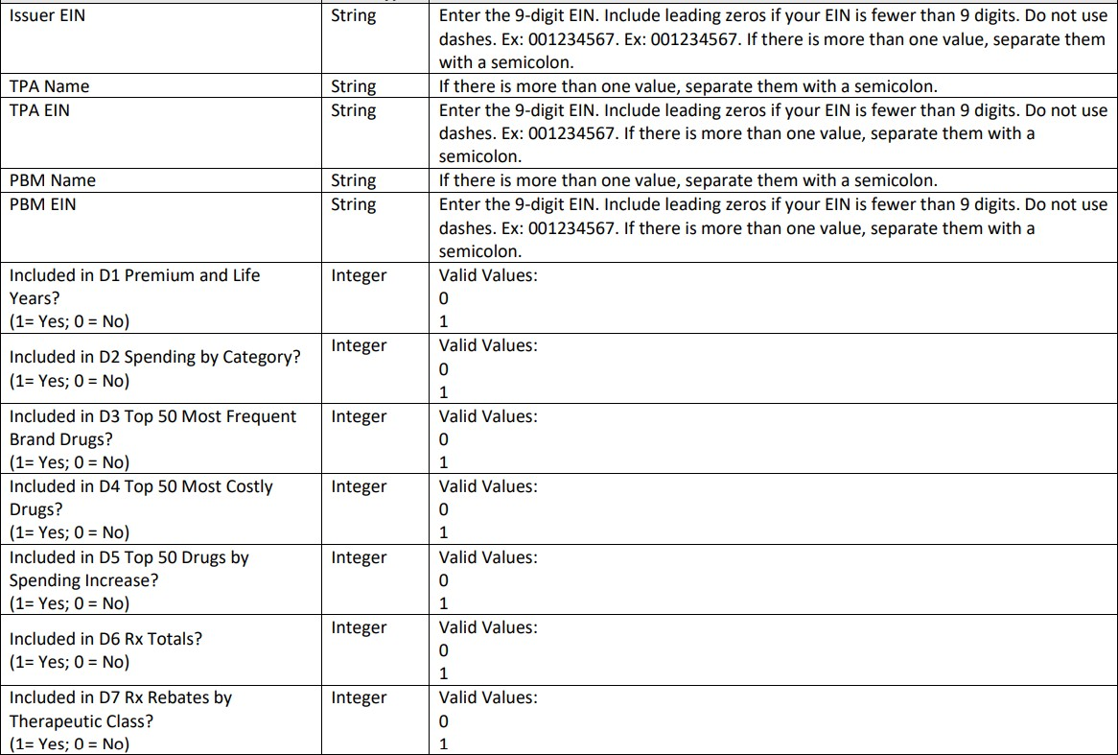
P2 Group Health Plan List¹
UHC will submit
For OptumRx Carve In
Submit 0 (standard)
Submit 1 (standard/ OptumRx carve in)
Important: The content in this guide reflects UnitedHealthcare/ OptumRx carve in and UMR approach. The guide includes content from: ¹ CMS Reporting Instructions as noted throughout.

Slide 13
CMS Site and Reference links
The CMS Portal is now open for Clients to submit their data.
Confirmation of completion of submission of RxDC data to CMS:
UHC will send a communication to our internal teams on 12/21 to confirm that we on track to complete the required submission to CMS.
There will be a follow up confirmation on 12/28 to confirm that the submission is complete.
The account teams may use these communications to provide updates to Clients, Brokers and Consultants.
CMS Site | Content
CMS Reporting Instructions | Contains details regarding reporting instructions and deadlines
CMS - Sign In | CMS.gov sign in link
HIOS RxDC User Manual (cms.gov) | HIOS RxDC User Manual
HIOS Portal User Manual (cms.gov) | HIOS Portal User Manual
Other Resources
Use the CAA Frequently Asked Questions document in the Pharmacy Benefits and Costs section to answer more of your questions.

